Slide 1
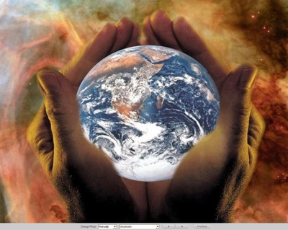
The Mysterious Change of the Season

Slide 2
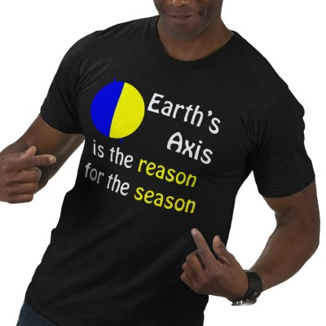
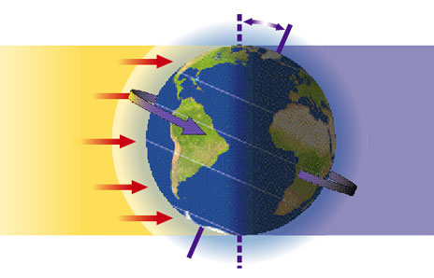
Earth’s axis of rotation
Imaginary poles on which Earth spins
Causes the change in seasons

Slide 3
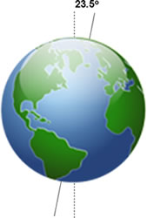
Earth’s tilt
23.5⁰ angle

Slide 4
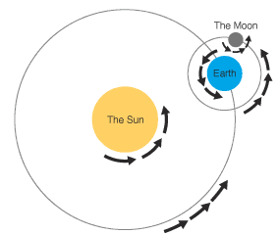
orbit
The path a planet or moon takes during its revolution

Slide 5
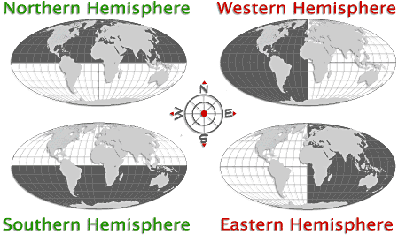
* hemisphere
half of a sphere

